Slide 1
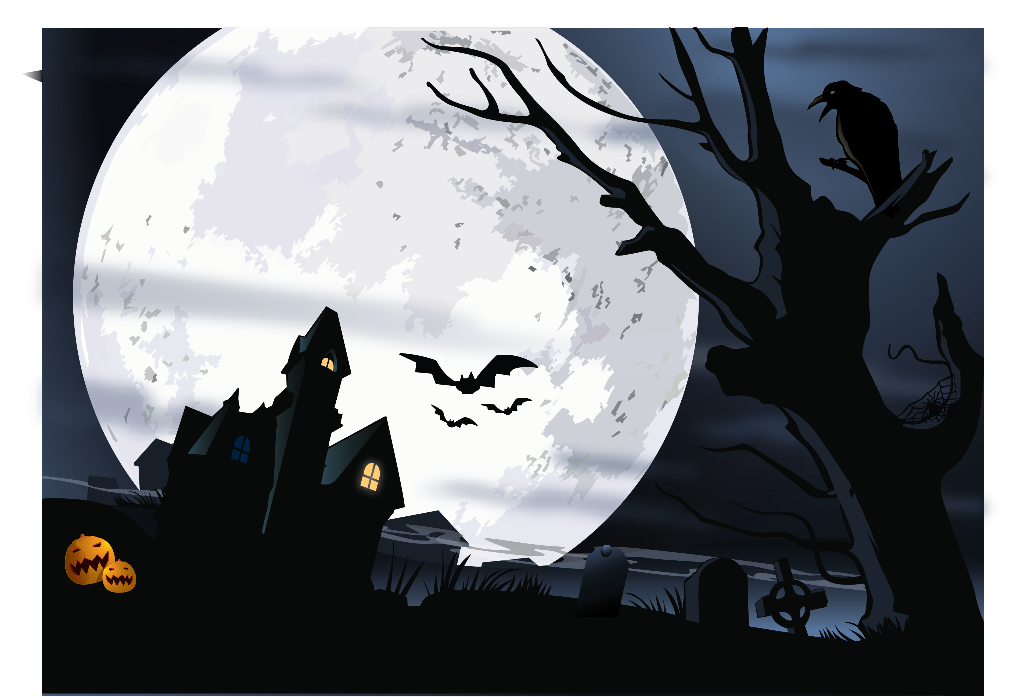

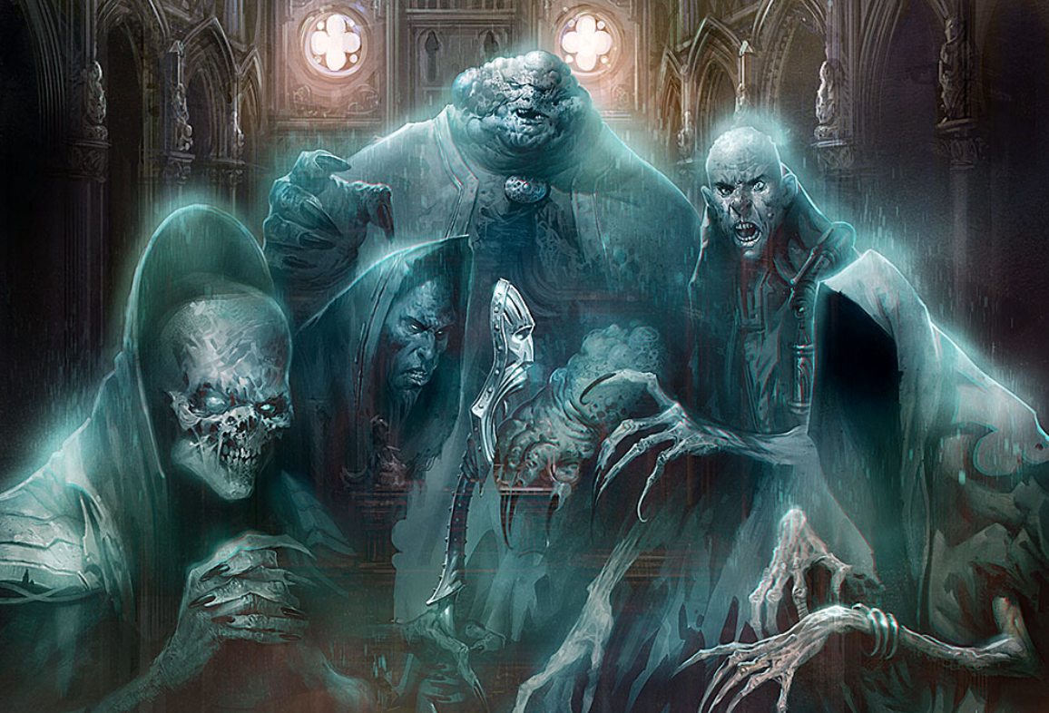



Slide 2
Problem Statement
Our world is occupied by spiritual creatures some are good some are bad, and some are very bad. We must know who we have around us. We thought of using machine learning algorithms to train our models based on characteristics of creatures based on past data we have and then become ready to predict the forthcoming creatures. What Say!
Most important thing here, as we know we have three classes of creatures. We must check our predictions accuracy in terms of precision and accuracy all the time. We can't have False Positive or False Negative because in both cases we will end up in scare of our lives!

Slide 3
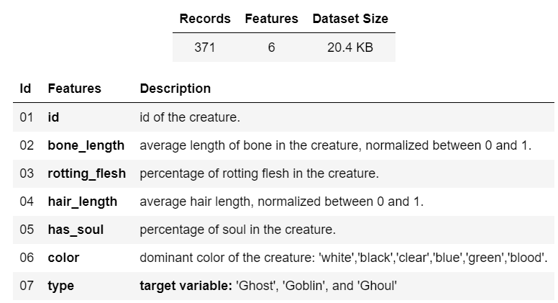
Our Dataset

Slide 4
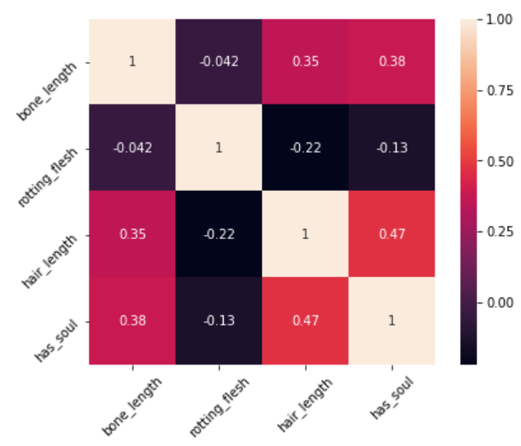
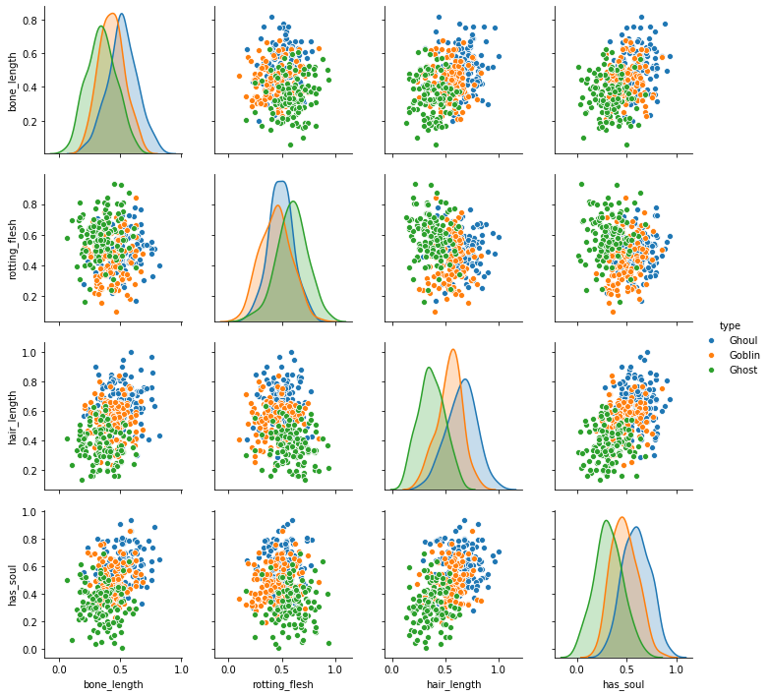
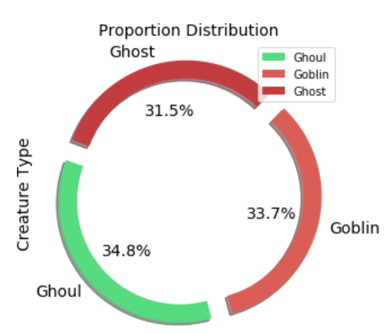
Key Features and Data Distribution

Slide 5
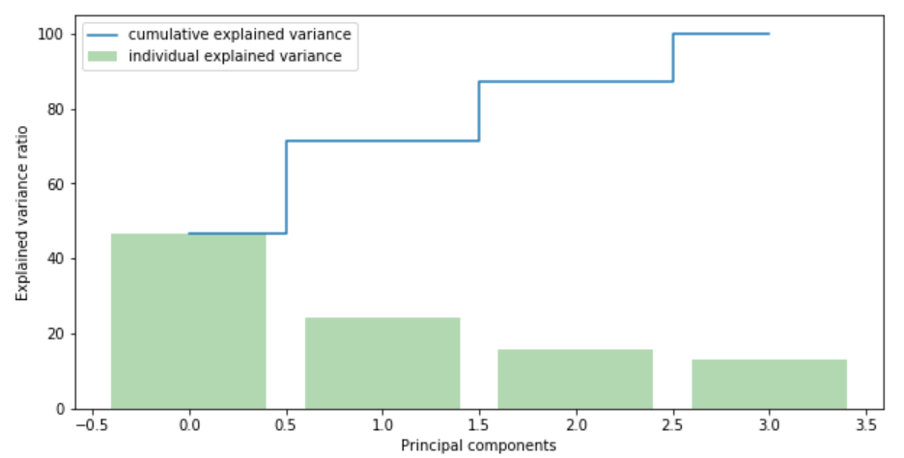
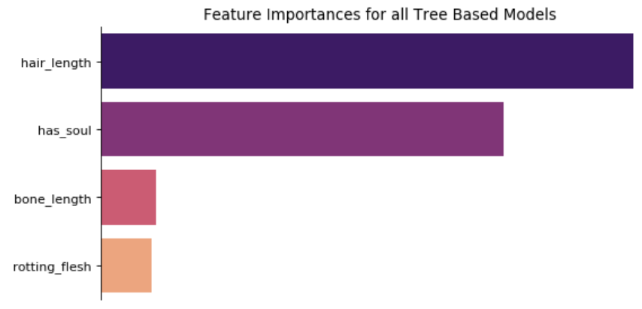
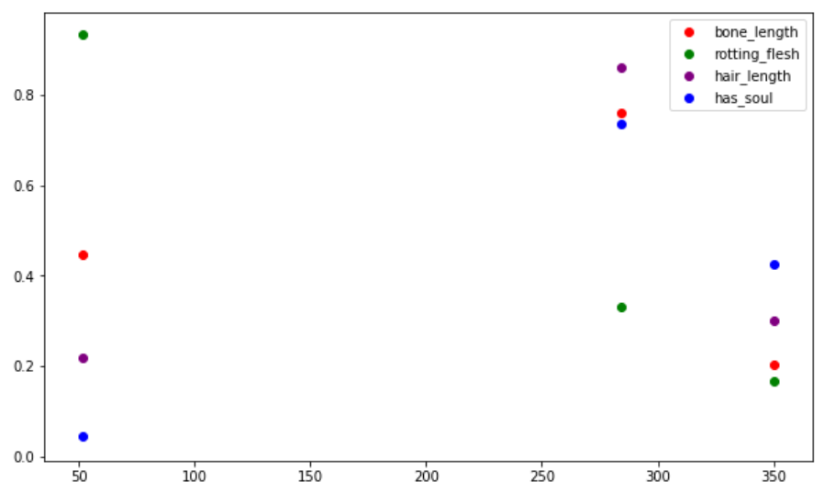
Features Selection & Anomaly Detection

Slide 6
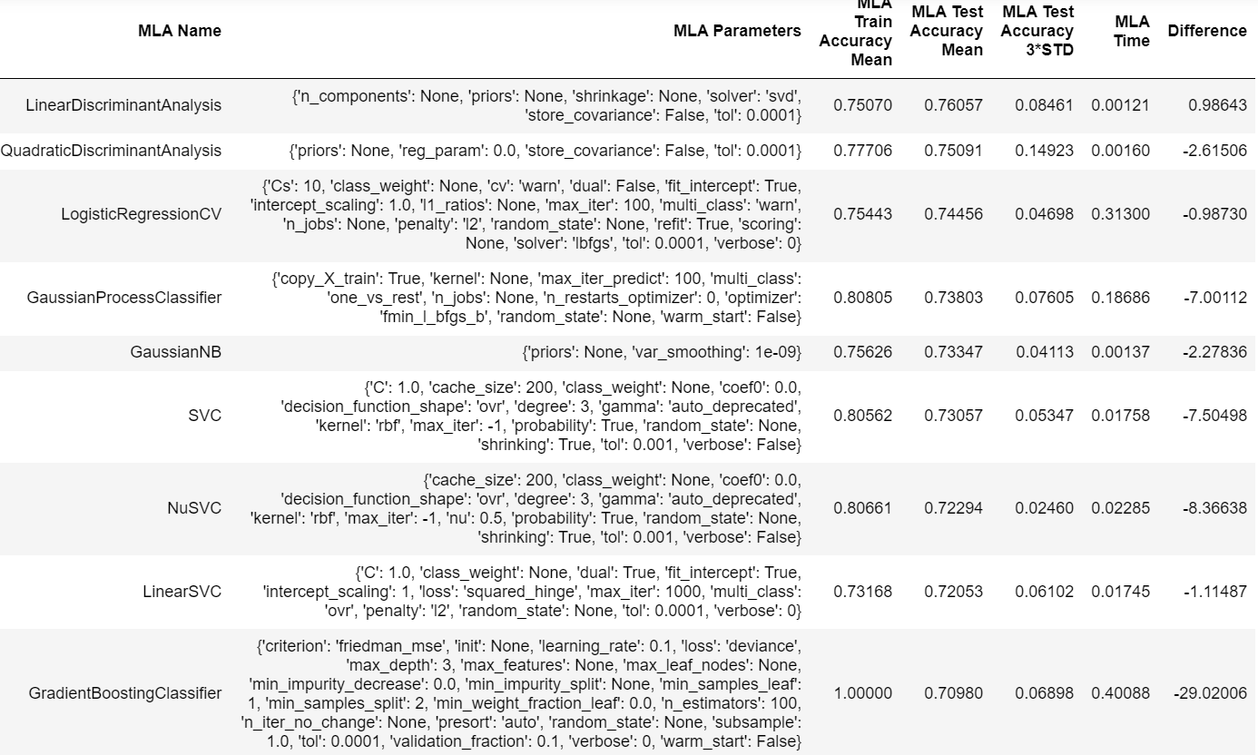
Base Models Train and Test Scores

Slide 7
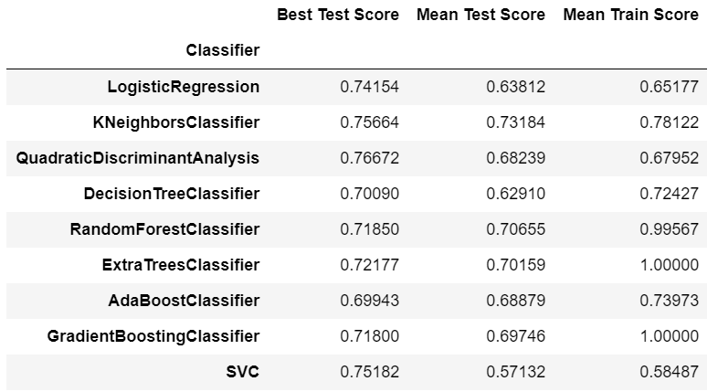
Models Train and Test Scores After Hyperparameters Tuning

Slide 8
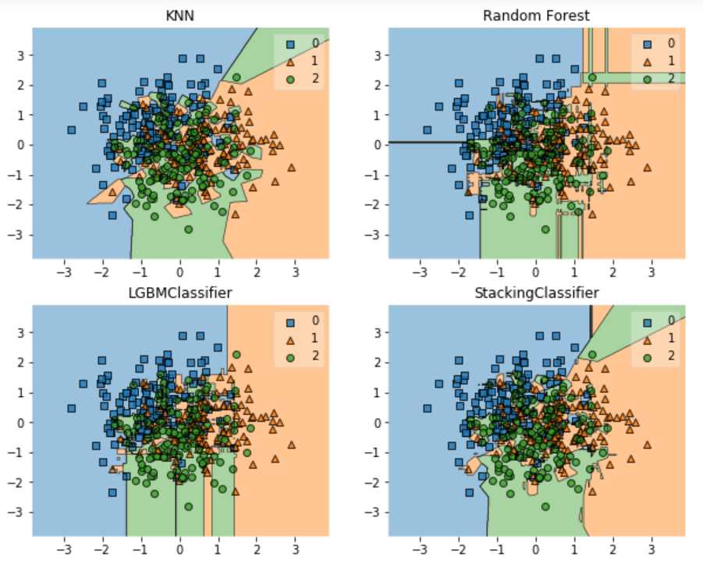
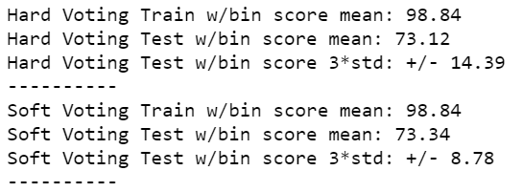
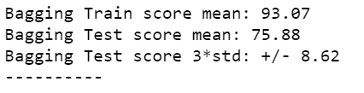
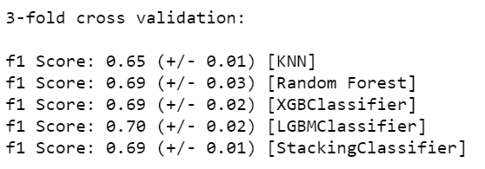
Ensemble Models Train and Test Scores

Slide 9
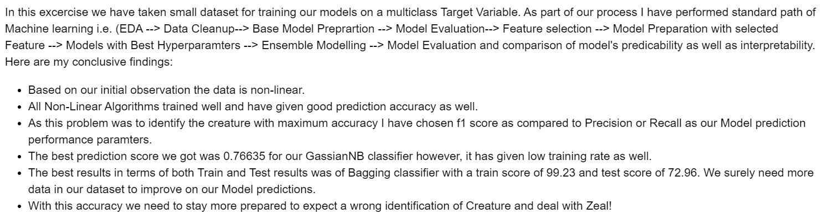

Conclusion
Thank You!

